Slide 1
Challenges
Mini challenge 3

Slide 2
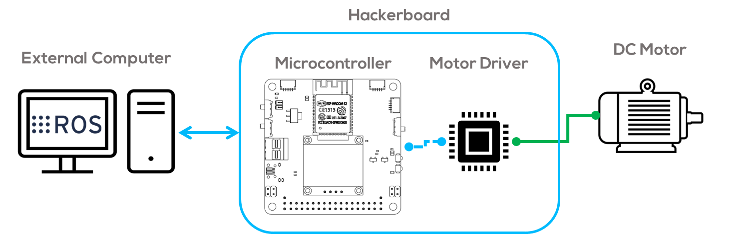
Mini Challenge 3
Introduction
This mini challenge is intended for the student to review the concepts introduced in the previous sessions.
The activity consists of creating several ROS nodes to regulate the speed of a DC Motor.
The motor will be controlled using an external computer, a microcontroller, and a motor driver.
See following slide for requirements.

Slide 3
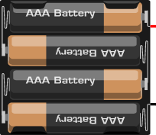
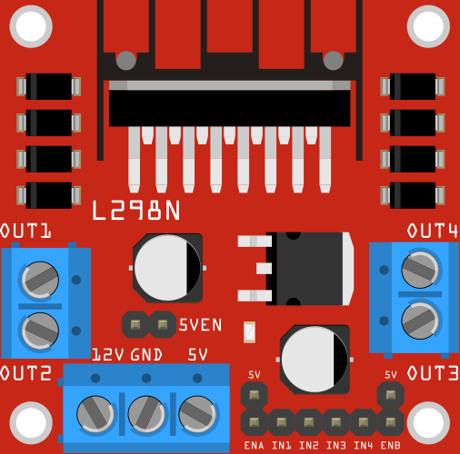
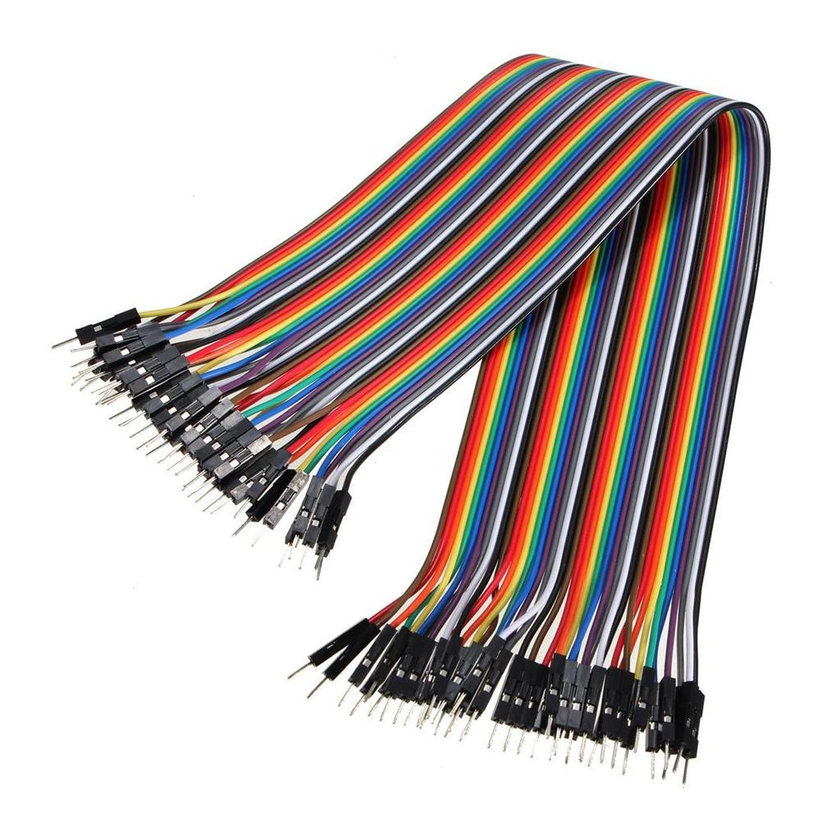
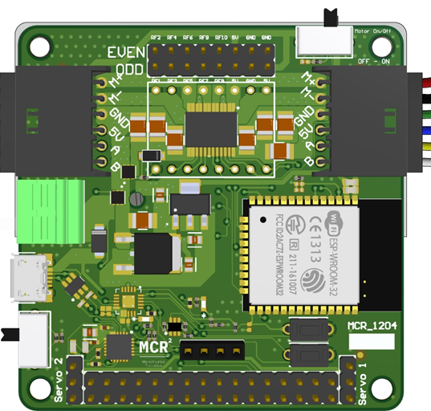
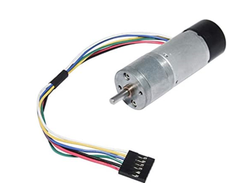
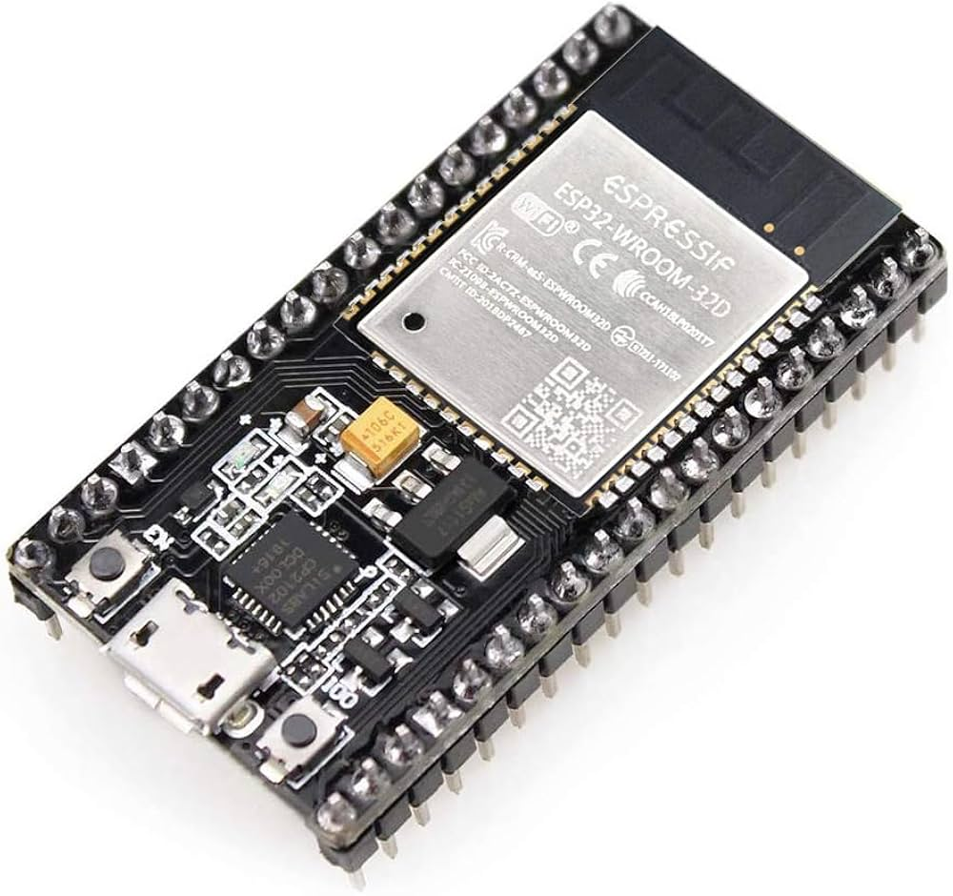
Mini Challenge 3: Requirements
Battery Pack
5 - 12 V
Battery Pack
5 - 12 V
Motor Driver L298n
Wires (Dupont or any wire)
6 VDC Brushed Motor
6 VDC Brushed Motor
Hackerboard
ESP32

Slide 4
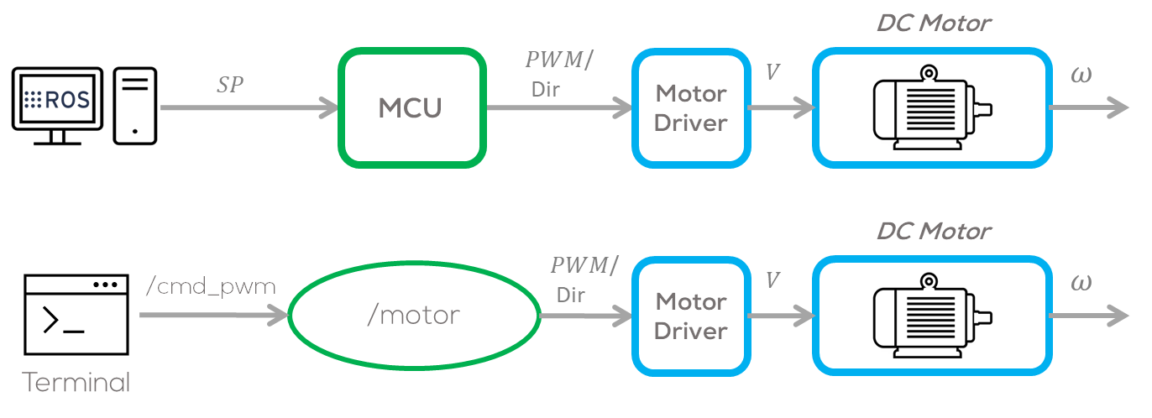
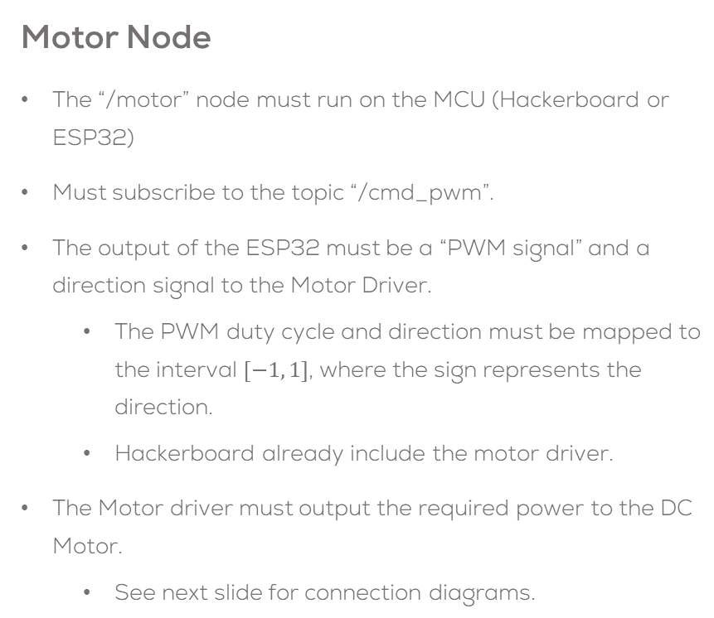
Mini Challenge 3
Motor Node
The “/motor” node must run on the MCU (Hackerboard or ESP32)
Must subscribe to the topic “/cmd_pwm”.
The output of the ESP32 must be a “PWM signal” and a direction signal to the Motor Driver.
The PWM duty cycle and direction must be mapped to the interval $[−1, 1]$, where the sign represents the direction.
Hackerboard already include the motor driver.
The Motor driver must output the required power to the DC Motor.
See next slide for connection diagrams.

Slide 5
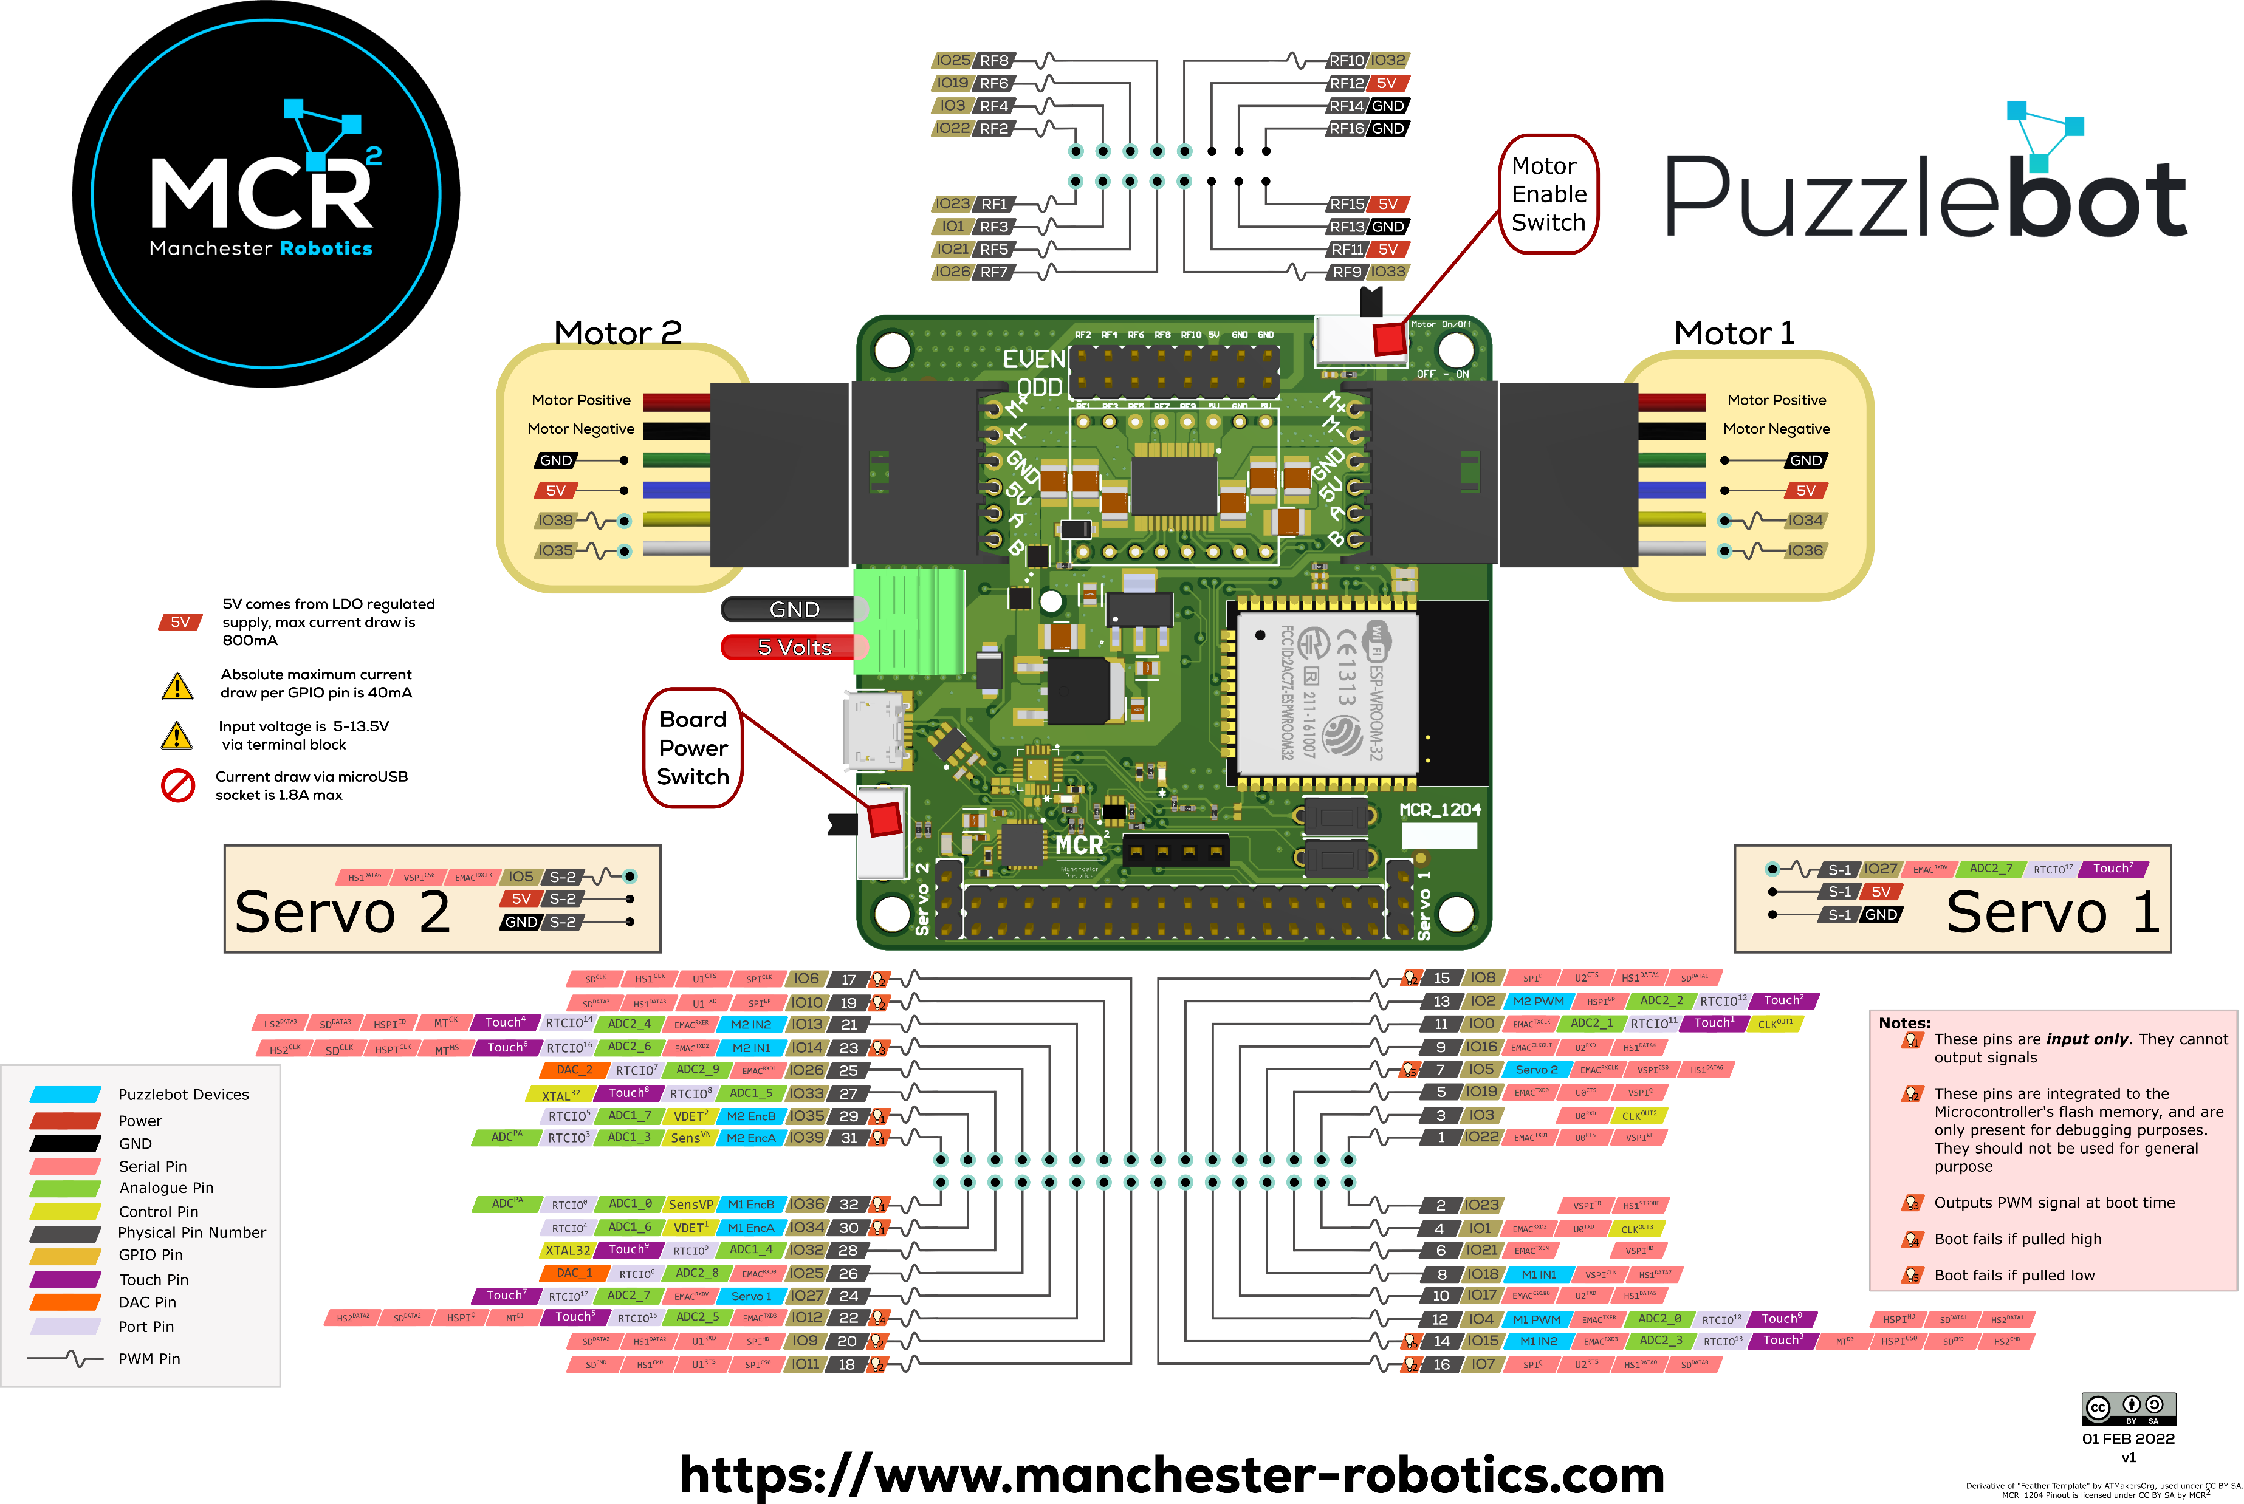

Slide 6
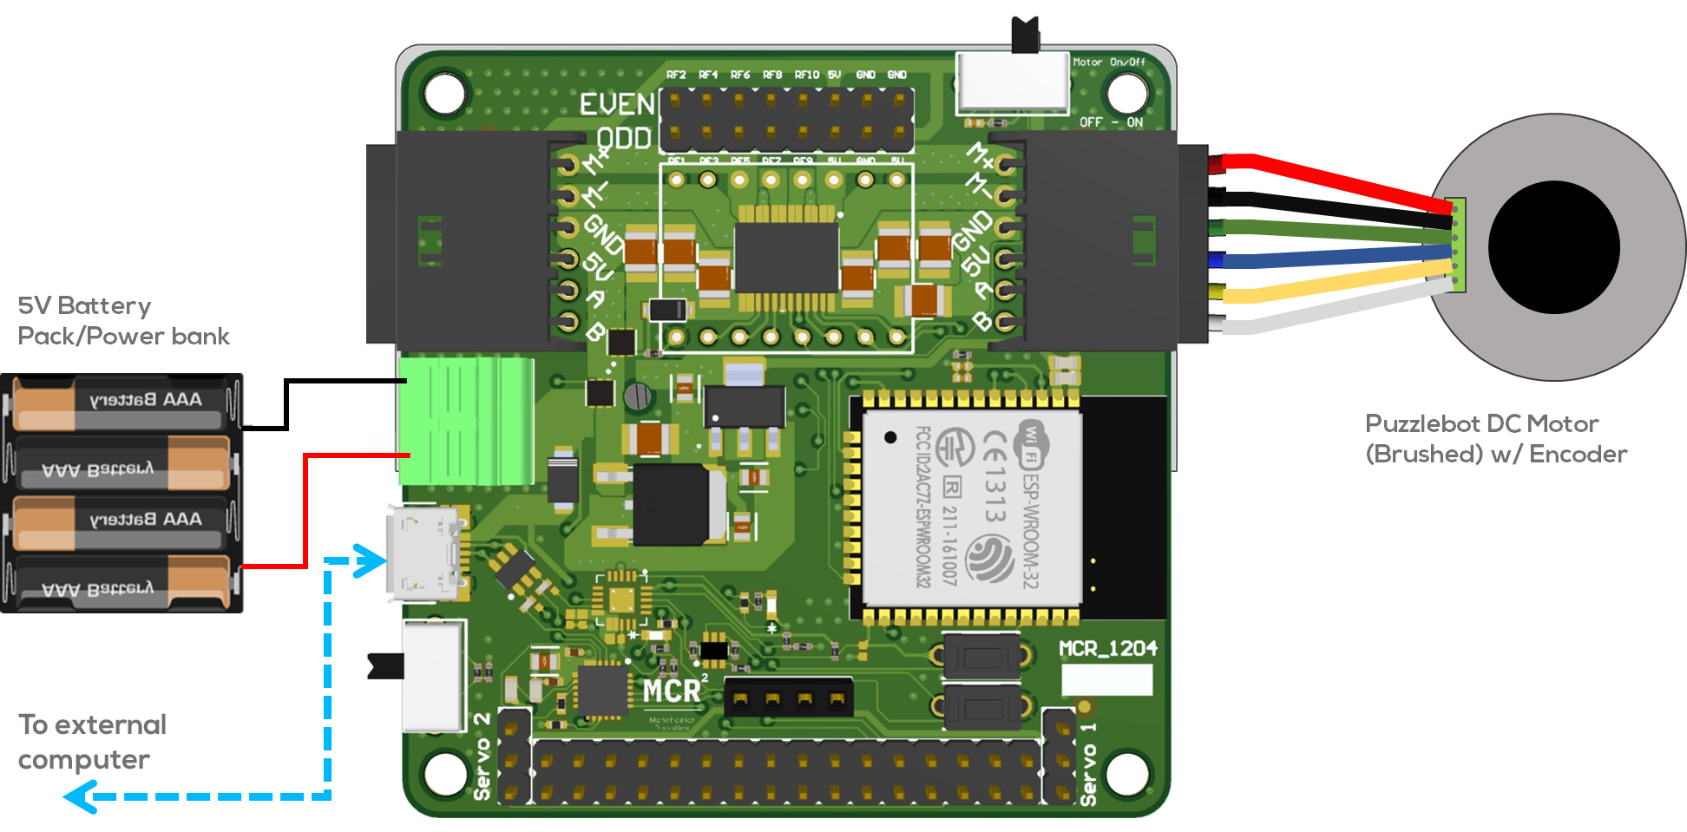
Mini Challenge 3: Connection Diagrams
Hackerboard, Motor Driver Pins:
M1 In1 = GPIO 18
M1 In2 = GPIO 15
M1 PWM = GPIO 04

Slide 7
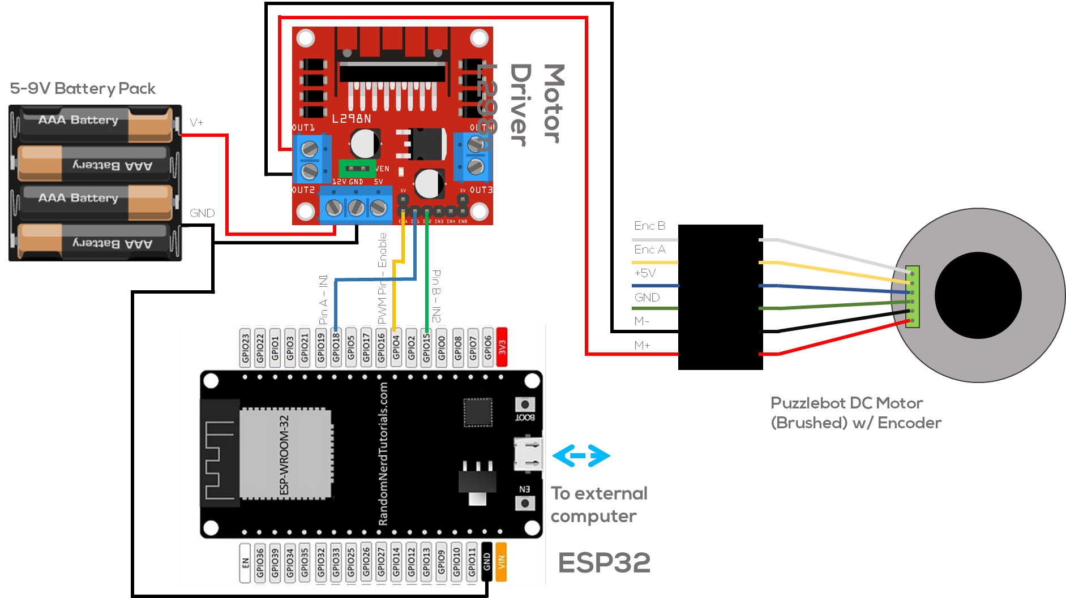
Mini Challenge 3: Connection Diagrams

Slide 8
Mini Challenge 3
Hints (ESP32/Hackerboard PWM)
The ESP 32 does not use the “analogwrite()” command to generate a PWM signal.
To generate a PWM signal the following steps must be followed.
Choose a PWM channel. There are 16 channels from 0 to 15.
Set the PWM signal frequency (980 Hz standard).
Set the signal’s duty cycle resolution. From 1 to 16 bits resolution (8 bits typical, 0 to 255 resolution).
Specify the output GPIO.
More information can be found here.
void setup(){
ledcSetup(ledChannel, freq, resolution);
ledcAttachPin(ledPin, ledChannel);
}
void loop(){
ledcWrite(ledChannel, dutyCycle);
delay(15);
}

Slide 9
Rules
This is challenge not a class. The students are encouraged to research, improve tune explain their algorithms by themselves.
MCR2(Manchester Robotics) Reserves the right to answer a question if it is determined that the questions contains partially or totally an answer.
The students are welcomed to ask only about the theoretical aspect of the classed.
No remote control or any other form of human interaction with the simulator or ROS is allowed (except at the start when launching the files).
It is forbidden to use any other internet libraires with the exception of standard libraires or NumPy.
If in doubt about libraires please ask any teaching assistant.
Improvements to the algorithms are encouraged and may be used as long as the students provide the reasons and a detailed explanation on the improvements.
All the students must be respectful towards each other and abide by the previously defined rules.
Manchester Robotics reserves the right to provide any form of grading. Grading and grading methodology are done by the professor in charge of the unit.

